Slide 1
EXPLAINABLE AI-BASED SOFTWARE BUG PREDICTION AND
RISK ANALYSIS SYSTEM
DEPARTMENT OF COMPUTER SCIENCE
JAWAHARLAL NEHRU TECHNOLOGICAL UNIVERSITY HYDERABAD
UNIVERSITY COLLEGE OF ENGINEERING SCIENCE AND TECHNOLOGY
DISSERTATION STAGE-01
DISSERTATION WORK REVIEW-01
AUGUST - 2026
SUBMITTED BY
R. Neha
22011P0541
5th Year - 1st Sem
CSE-IDP
UNDER THE SUPERVISION OF
Dr. K. Suresh Babu
M.Tech., Ph.D (CSE)
Professor of CSE

Slide 2
Abstract
2
Software bugs can affect the quality and reliability of software. This project uses Machine Learning techniques to predict software modules that may contain bugs. Logistic Regression, Decision Tree, Random Forest, and XGBoost are used for prediction. NearMiss is applied to handle imbalanced data, and SHAP is used to explain the prediction results. The system helps developers identify risky modules early and improve software quality

Slide 3
Introduction
3
Software Bug
Bug Prediction
A defect or error in software that can cause incorrect results,
failures, or unexpected behaviour.
Uses software metrics and historical defect information to
estimate which components are likely to contain defects.
Risk Analysis
Explainability
Helps prioritize potentially risky components so testing and
debugging effort can be focused where it is most needed.
Provides insight into why a Machine Learning model
produced a particular prediction.

Slide 4
Problem Statement
4
Identifying bugs or defect-prone software modules early is difficult and time-consuming. Existing ML-based predictions may also lack clear explanations. Therefore, a system is needed to predict potential software defects and provide understandable explanations, and identify the module risk level.

Slide 5
Objectives
5
To predict software defects using Machine Learning.
To identify high-risk software modules.
To handle imbalanced data using NearMiss.
To explain predictions using SHAP.
To compare different ML models.

Slide 6
Motivation
6
Software bugs can reduce software quality and reliability.
Reduce unnecessary testing effort and maintenance effort.
Help developers focus on high-risk modules.
ML can help automate bug prediction.
Explainable AI helps developers understand the predictions.

Slide 7
Machine Learning Models and Their Roles
11
Logistic Regression
Decision Tree
It predicts whether a software module is defective
or non-defective
It makes predictions using simple decision rules.
Random Forest
XGBoost
Combines multiple decision trees to improve
robustness and prediction performance.
It builds models step by step to improve
prediction accuracy

Slide 8
Risk Analysis
12
Predict whether a software module is defective or non-defective.
Identify the risk level of each module.
High Risk → needs immediate attention.
Medium Risk → needs monitoring.
Low Risk → lower priority.
Use SHAP to understand the factors contributing to the risk.

Slide 9
Explainable AI and SHAP
Explainable AI (XAI)
Explains why the ML model predicts a software module as buggy or non-buggy.
Makes ML predictions understandable and interpretable to developers.
SHAP(SHapley Additive exPlanations)
Shows how each feature contributes to the model's prediction.
Identifies the most important software metrics influencing bug prediction.

Slide 10
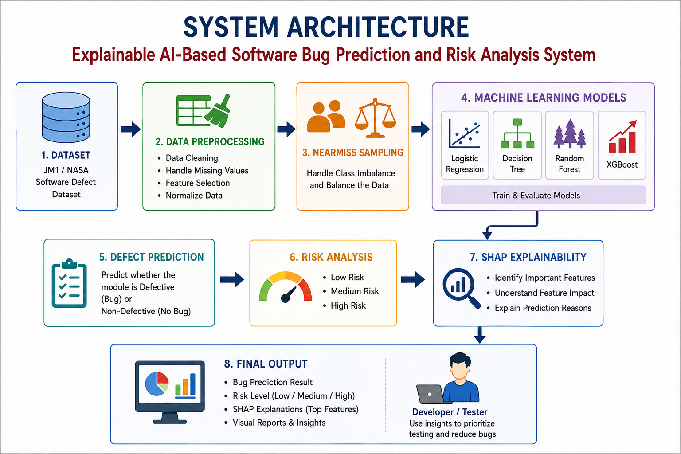

Slide 11
Methodology
15
Dataset Collection ↓ Data Preprocessing ↓ Handle Class Imbalance ↓ Train ML Models ↓ Defect Prediction ↓ Risk Analysis ↓ SHAP Explanation

Slide 12
Evaluation Metrics
16
Accuracy
Precision
Recall
Overall proportion of correct predictions.
How many predicted defective components
are actually defective.
How many actual defective components
are correctly identified.
F1-Score
Model Comparison
Compare the selected ML models using the
evaluation metrics.
Harmonic mean of precision and recall.

Slide 13
References
[1] T. Menzies, J. Greenwald, and A. Frank, “Data mining static code attributes to learn defect predictors,” IEEE Trans. Software Engineering, vol. 33, no. 1, pp. 2–13, Jan. 2007.
[2] T. Hall, S. Beecham, D. Bowes, D. Gray, and S. Counsell, “A systematic literature review on fault prediction performance in software engineering,” IEEE Trans. Software Engineering, vol. 38, no. 6, pp. 1276–1304, Nov./Dec. 2012.
[3] S. M. Lundberg and S.-I. Lee, “A unified approach to interpreting model predictions,” in Proc. 31st Int. Conf. Neural Information Processing Systems (NeurIPS), 2017, pp. 4765–4774.
[4] T. Chen and C. Guestrin, “XGBoost: A scalable tree boosting system,” in Proc. 22nd ACM SIGKDD Int. Conf. Knowledge Discovery and Data Mining (KDD), 2016, pp. 785–794.

Slide 14
Thank You

